Slide 1
電腦視覺與深度學習 (Computer Vision and Deep Learning) Homework 2
TA:
真禎: nckubot65904@gmail.com
Office Hour: 14:00~16:00, Mon.
10:00~12:00, Fri.
At CSIE 9F Robotics Lab.

Slide 2
Notice (1/2)
Copying homework is strictly prohibited!! Penalty: Score will be zero for both persons!!
Due date => 09:00:00, 2022/12/08 (Thu.)
No delay. Penalties for late homework:
Up to 7 days late, loss of 50% of the score awarded
After 7 days, the score will be marked as 0.
You must attend the demonstration, or your score will be 0. The demonstration schedule will be announced on NCKU moodle.
You must make a GUI and follow the format, or you will get some penalties.
Upload to => 140.116.154.1 -> Upload/Homework/Hw2
Upload/Homework/Hw2_05
User ID: cvdl2022 Password: cvdl2022
Format
Filename: Hw2_StudentID_Name_Version.rar
Hw2_05_StudentID_Name_Version.rar
Ex: Hw2_F71234567_林小明_V1.rar
If you want to update your file, you should update your version to be V2.
Ex: Hw2_F71234567_林小明_V2.rar
Content: project folder*( excluding the data, only source code and model) *note: remove your “Debug” folder to reduce file size
2

Slide 3
Notice (2/2)
Python
Python 3.7 (https://www.python.org/downloads/)
opencv-contrib-python (3.4.2.17)
Matplotlib 3.1.1
UI framework: pyqt5 (5.15.1)
3

Slide 4
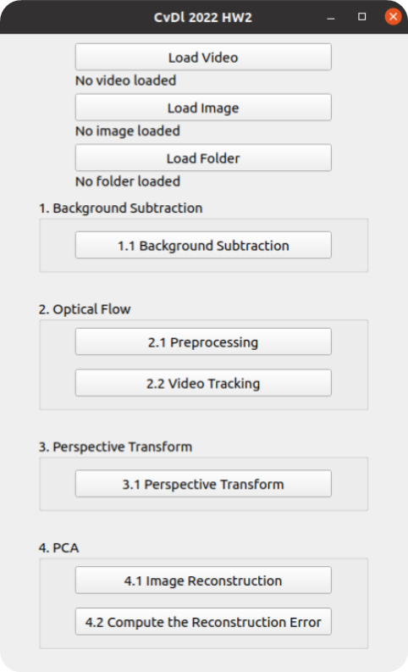
Assignment scoring (Total: 100%)
Don’t fix your data path
(There is another dataset for demonstration)
1. (20%) Background Subtraction
2. (20%) Optical Flow
2.1 (10%) Preprocessing
2.2 (10%) Video tracking
3. (20%) Perspective Transform
4. (20%) PCA
4.1 (10%) Image Reconstruction
4.2 (10%) Compute the reconstruction error
5. (20%) Train a Cat-Dog Classifier Using ResNet50
5.1 (3%) Load the dataset and resize images
5.2 (3%) Plot class distribution of training dataset
5.3 (3%) Show the structure of ResNet50 model
5.4 (3%) Set up 2 kinds of loss functions to train 2 ResNet50 models
5.5 (4%) Compare the accuracies of 2 ResNet50 models on validation dataset
5.6 (4%) Use the better-trained model to run inference and show the predicted class label
(出題：Sam)
(出題：Chong)
(出題：Jack)
(出題：Jeff)
(出題： Benjamin)
Question 5 needs to upload separately.

Slide 5
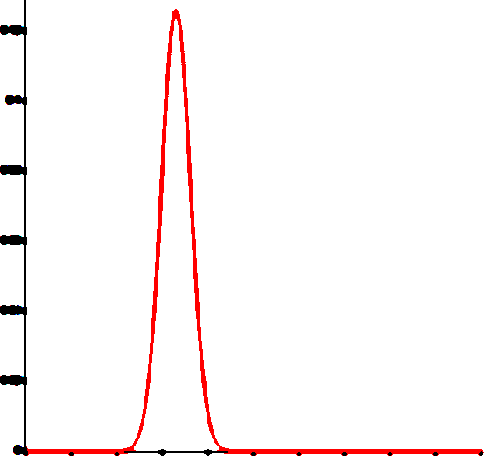
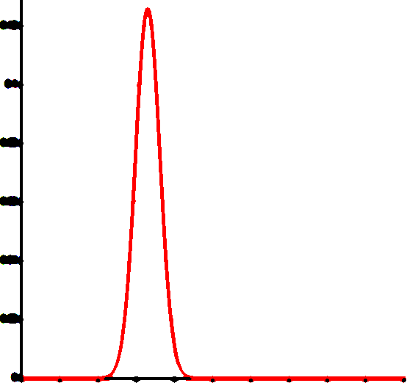
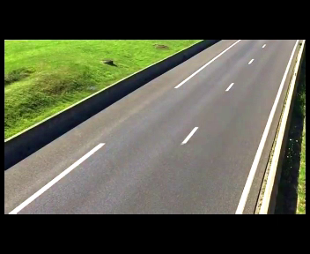
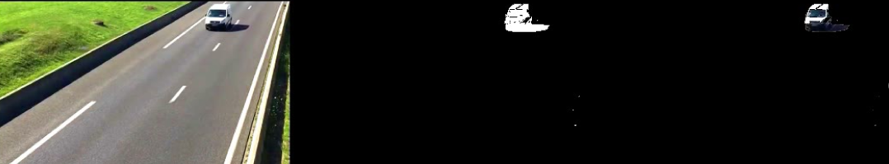
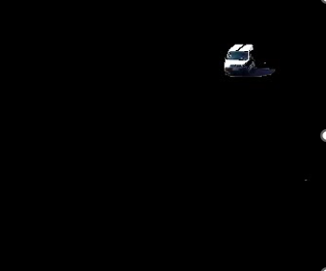
1. (20%) Background Subtraction: Simple Gaussian Model (1/2)
(出題：Sam)
Given: a video in Q1_Image/Traffic.mp4
Requires:
Click the button “1.1 Background Subtraction” to show 3 windows:
Origin video: Traffic.mp4
Mask video: (background: black: 0, foreground: white: 255)
Foreground video
Use first 25 frames to build the background model
DO NOT use OpenCV function: cv2.createbackgroundSubtractor()
1. Build Gaussian model of Background
Frame =0~24
Build one gaussian model at every pixel position
Image height
Each pixel will have a mean
and a standard deviation (total width x height models)
Frame =0~24
Image width
Output: w x h gaussian models (mean and std)
2. Remove Background:
Test new pixel belongs to foreground or background
If Frame(x , y) - mean > std*5 ,then mask(x , y) = 255
mean
= 25
mean
= 25
If Frame(x , y) - mean <= std*5 ,then mask(x , y) = 0
Ex:
mean = 25
std = 3
AND
std*5
= 15
std*5
= 15
Frame > 24
mask
Frame(x , y) = 28
Frame(x , y) = 60
Foreground
Belongs to Background , mask(x , y) = 0
Belongs to Foreground , mask(x , y) = 255

Slide 6
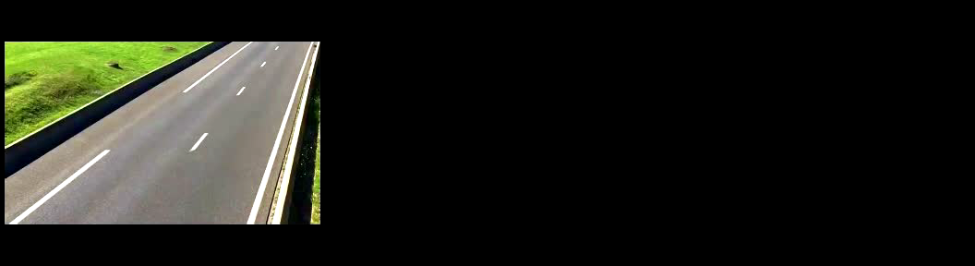
1. (20%) Background Subtraction: Simple Gaussian Model (2/2)
(出題：Sam)
Hint:
Convert video frames to Gray (cv2.cvtColor)
For every pixels in video from 0~24 frames, build a gaussian model with mean and standard deviation (if standard deviation is less then 5, set to 5)
For frame > 24, test every frame pixels with respective gaussian model. If gray value difference between testing pixel and gaussian mean is larger than 5 times standard deviation, set testing pixel to 255 (foreground, white), 0 (background, black) otherwise.
Remove background (cv2.bitwise_and)
Demo video:
1)
2)

Slide 7
2. (20%) Optical Flow
(出題：Chong)
2.1 (10%) Preprocessing
2.2 (10%) Video tracking

Slide 8

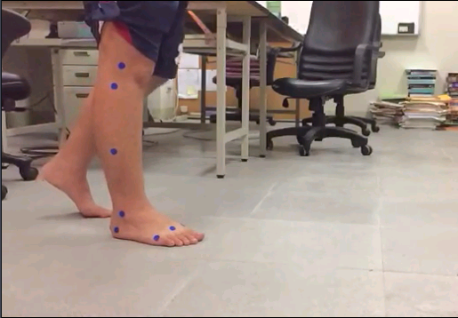
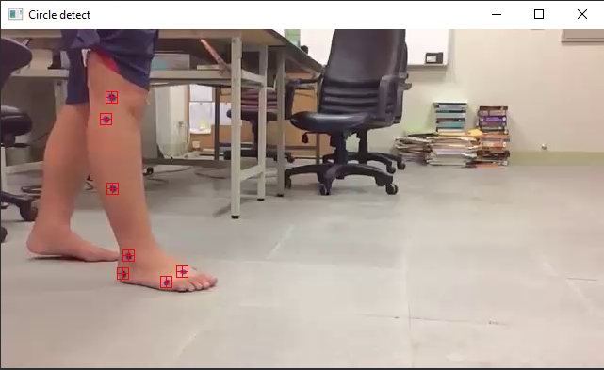
2.1 Preprocessing (10%)
(出題：Chong)
Given a video: optical_flow.mp4
Q: Detect the 7 blue circles and display 1 image (First Frame only). with them marked with a red square bounding box and cross mark.
size: 12px
Not this
Center point
Ex:
7 blue circles
(0,0)
x
y
※ Tip: Draw your own marker with opencv functions cv.rectangle() and cv.line()

Slide 9
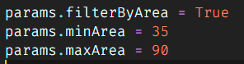
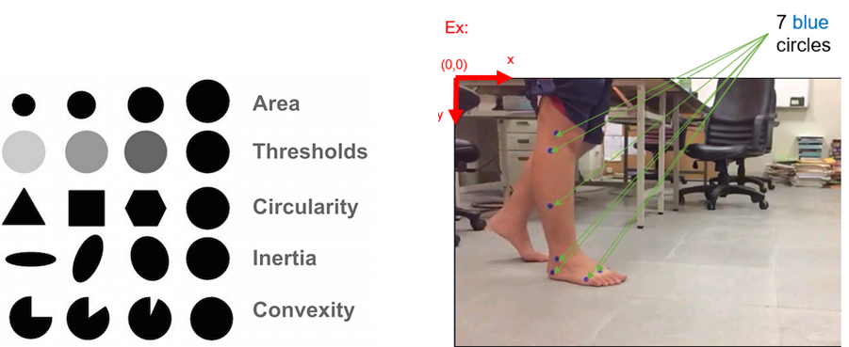
How to detect center points of 7 blue circles
(出題：Chong)
You can use cv2.SimpleBlobDetector_create() to detect blobs (binary large object), it can filter out blobs by different properties:
Area (of blob in pixels, e.g. 100 px)
Color (gray level, 0 for black, 255 for white)
Circularity (if perfect circle, then it is 1.0)
Inertia (ratio of the minor and major axes from 0.0 to 1.0)
Convexity (if no gap, then it is 1.0)
Minimum and maximum bounds can be chosen. E.g. ->
Colour

Slide 10
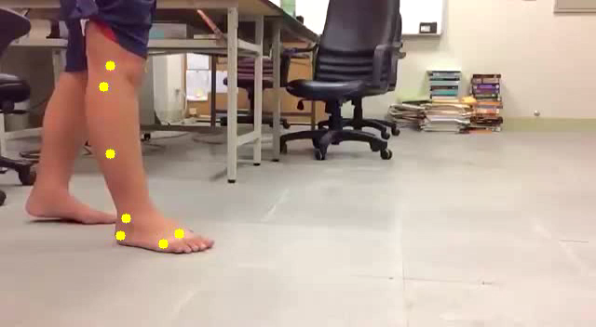

2.2 Video tracking (10%)
(出題：Chong)
Q: Click button to:
(5%) Track the 7 center points on the whole video using OpenCv function cv2.calcOpticalFlowPyrLK. Ex: https://github.com/opencv/opencv/blob/master/samples/cpp/lkdemo.cpp
(5%) Display the trajectory of each of the 7 tracking points throughout the video. Pick a color that is highly visible. Ex: the demo videos bellow.
Tool site:
Load video
Circle detect
Optical flow
Optical flow Tutorial
Demo videos:
※ Tracking process may have some errors. At least 4-5 points should be tracked with success.

Slide 11
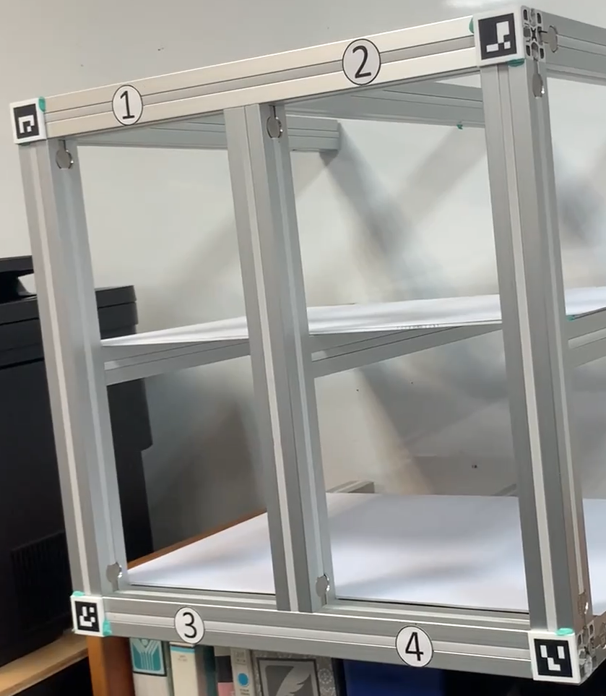
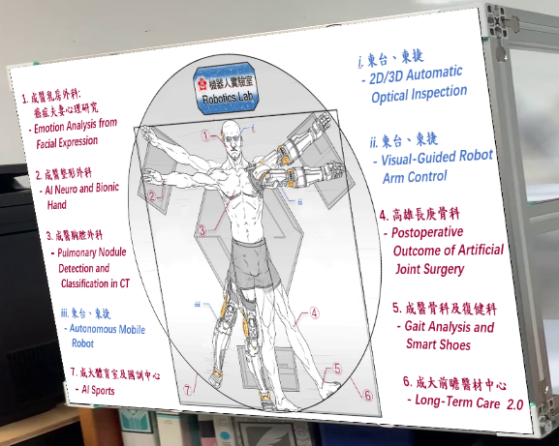
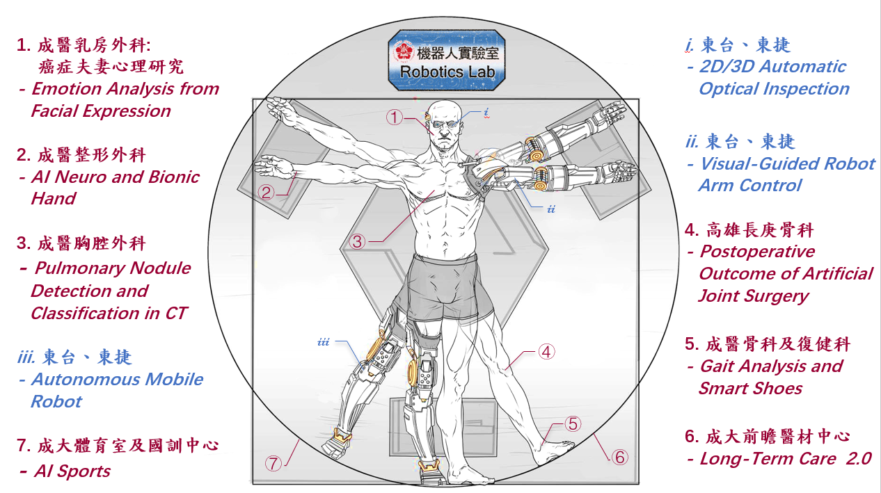
3. (20%) Perspective Transform:
(出題：Jack)
Given video.mp4 and logo.png
Read the test video and process frame by frame using cv2.VideoCapture()
Detect the four ArUco makers position (x, y) each frame using cv2.aruco.detectMarkers()
Get homography matrix from {C1, C2, C3, C4} mapping to {ID1, ID2, ID3, ID4} using cv2.findHomography()
Do perspective transform by homography matrix using cv2.warpPerspective()
Show result video using cv2.imshow()
(0, 0)
x
y
ID2
C1
C2
ID1
Result
C3
C4
ID4
ID3

Slide 12
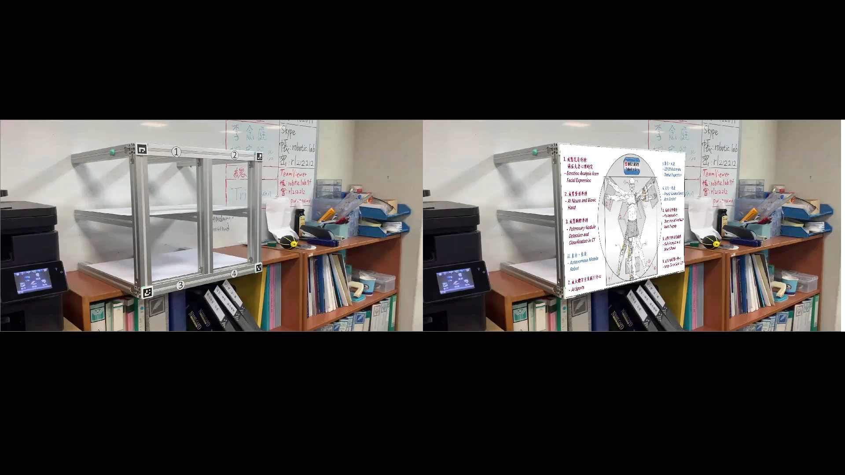
3. (20%) Perspective Transform:
(出題：Jack)
User Interface
1)
Click the button “Load Video” to load video.mp4
Click the button “Load Image” to load logo.png
2)
Click the button “3.1 Perspective Transform” to show following video

Slide 13
4. (20%) PCA
(出題：Jeff)
4.1 (10%) Image Reconstruction
4.2 (10%) Compute the reconstruction error

Slide 14
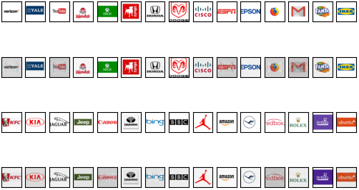
4.1 (10%) PCA - Image Reconstruction (1/2)
(出題：Jeff)
Given: 30 Images of Company logo
Q1: Using PCA(Principal components analysis) to do dimension reduction from 100% to 80% and then reconstruct it back using the reduced dimension data.
Click “4.1 Image Reconstruction” button and show original and reconstructed images like below. (You should not save the reconstructed images and load them when clicking “4.1 Image Reconstruction” button. Instead, output the result immediately when you done reconstruct them.)
Hint: Use PCA from python library: sklearn.decomposition
Use show original and reconstructed images: matplotlib.pyplot
origin
reconstruction
(Name of each row (origin, reconstruction) is optimum)
origin
reconstruction

Slide 15
4.1 (10%) PCA - Image Reconstruction (1/2)
(出題：Jeff)
Given: 30 Images of Company logo
Step:
1. Load all of the 30 Images of Company logo.
2. Flatten each image into 1D array.
3. Concatenate all flatten image into 2D data. (Each row is one of flatten images)
4. Analyses the 2D data using PCA , reduce the component from 30 to 27.
Hint: sklearn.decomposition.PCA( ), PCA.fit_transform( )
5. Reconstruct image from reduced data.
Hint: PCA.inverse_transform( )
Normalize the reconstructed image from using formular to make value fall in the range
[0, 255]
Hint: cv2.normalize( )
6. Plot and show the origin image and the reconstructed image using matplotlib.pyplot like picture in last page. (Name of each row (origin, reconstruction) is optimum)

Slide 16
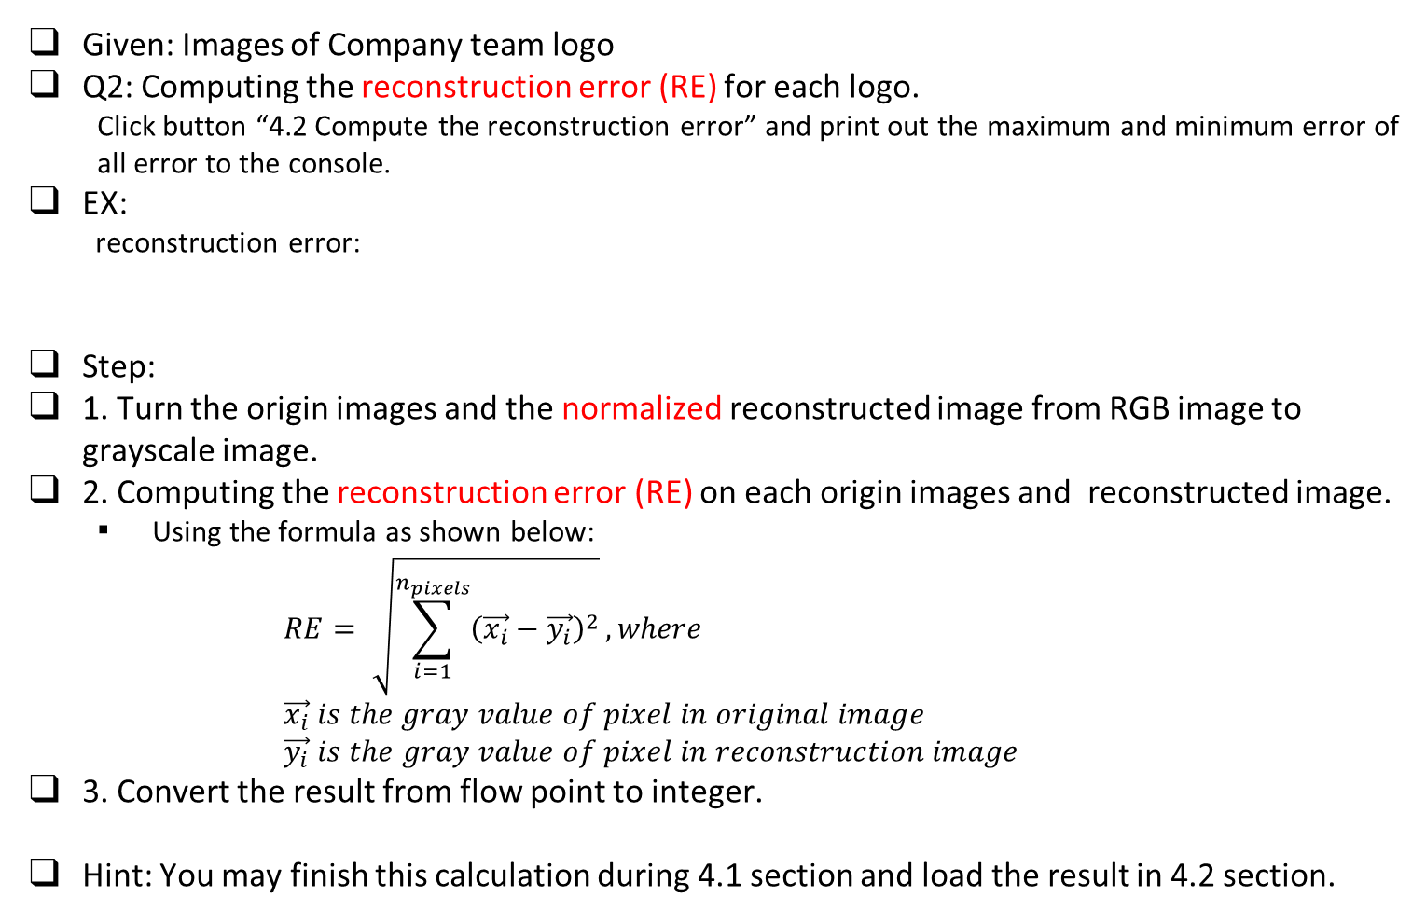
4.2 (10%) PCA - Compute the Reconstruction Error (2/2)
(出題：Jeff)
Given: Images of Company team logo
Q2: Computing the reconstruction error (RE) for each logo.
Click button “4.2 Compute the reconstruction error” and print out the maximum and minimum error of all error to the console.
EX:
reconstruction error:
Step:
1. Turn the origin images and the normalized reconstructed image from RGB image to grayscale image.
2. Computing the reconstruction error (RE) on each origin images and reconstructed image.
Using the formula as shown below: $RE= \sqrt{\sum_{i=1}^{n_{pixels}}{{\left(\vec{x_{i}}−\vec{y_{i}}\right)}^{2}}}, where$ $\vec{x_{i}} is the gray value of pixel in original image$ $\vec{y_{i}} is the gray value of pixel in reconstruction image$
3. Convert the result from flow point to integer.
Hint: You may finish this calculation during 4.1 section and load the result in 4.2 section.
max error: 4253
min error: 1251

Slide 17
5. Train a Cat-Dog Classifier Using ResNet50 (20%)
(出題：Benjamin)
5.1 (3%) Load the dataset and resize images
5.2 (3%) Plot class distribution of training dataset
5.3 (3%) Show the structure of ResNet50 model
5.4 (3%) Set up 2 kinds of loss functions to train 2 ResNet50 models
5.5 (4%) Compare the accuracies of 2 ResNet50 models on validation dataset
5.6 (4%) Use the better-trained model to run inference and show the predicted class label

Slide 18
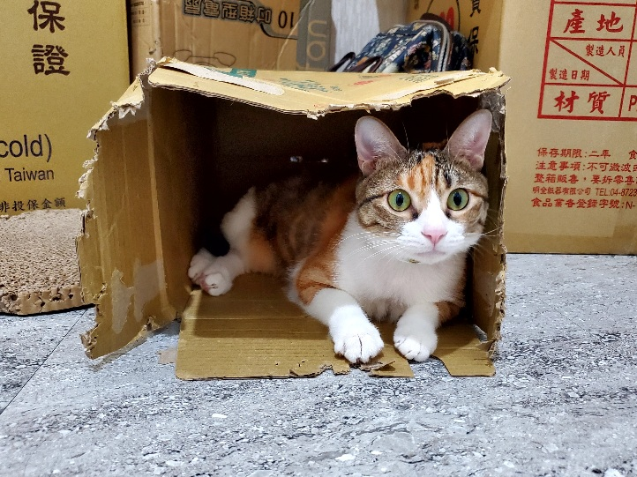
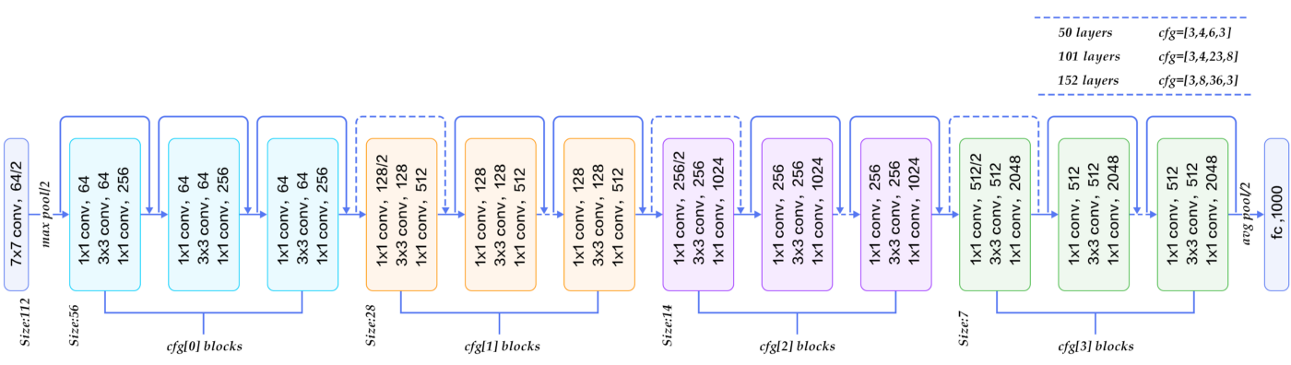
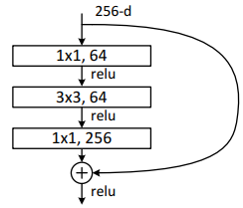
5.0 Train a Cat-Dog Classifier Using ResNet50
(出題：Benjamin)
Objective
Learn how to train a ResNet50 model to classify images of cats and dogs
Learn how to deal with imbalanced data
ResNet50
Residual learning: avoid degradation problems
Bottleneck: build a deeper network without additional parameters
Cats and Dogs Dataset (modified from Kaggle Cats and Dogs Dataset)
Data type: JPG images
2 classes: Cat and Dog
Datasets
Path: /Download/Homework/Hw2/Dataset_OpenCvDl_Hw2_Q5.zip
Training dataset: 16,200 JPG images in total. However, the dataset is imbalanced.
Validation dataset: 1,800 JPG images in total.
Inference dataset: 10 JPG images in total. It is for testing the inference function in your GUI program.
Input: an RGB image 224×224×3c
112×112×64c
3×3
/2: stride = 2
56×56×256c
×3
Every conv layer is followed by a BN layer and a ReLU layer
28×28×512c
×3
BN: Batch Normalization
ReLU: Rectified Linear Unit
×5
14×14×1024c
×2
7×7×2048c
R. Reference
Deep Residual Learning for Image Recognition
Kaggle Cats and Dogs Dataset
global avg pool
FC, 1c
FC: fully connected
Figure: Residual Block (with bottleneck)
Output: a confidence value (range: 0 ~ 1)
Figure: ResNet50 model structure

Slide 19
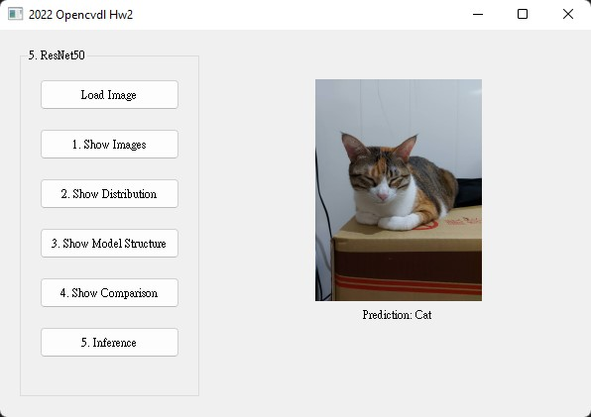
5.0 Train a Cat-Dog Classifier Using ResNet50
(出題：Benjamin)
Requirements
Train ResNet50 models with TensorFlow or PyTorch
Every chart should have a chart title and axis titles
Organize the files in this structure:
Hw2_05_StudentID_Name_Version // project folder
|-- model // folder to put trained models
|-- inference_dataset
|-- Cat
|-- Dog
|-- main.py // codes for your GUI program
|-- train.py // codes for model training
|-- ⁞ // other files or folders you need
Notice: Please include the inference dataset in your homework file.
Figure: GUI example

Slide 20
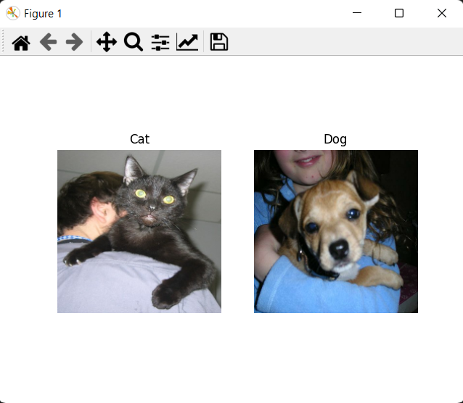
5.1 (3%) Load the dataset and resize images
(出題：Benjamin)
Objective
At home:
Load the training dataset and validation dataset
→ Hint:
(a) TensorFlow (tutorial): tf.keras.utils.image_dataset_from_directory()
(b) PyTorch (tutorial): torch.utils.data.Dataset
Resize images to 224×224×3c (RGB)
→ Hint:
(a) TensorFlow: tf.keras.utils.image_dataset_from_directory(image_size=(?, ?))
(b) PyTorch (tutorial): torchvision.transform
When the demo:
Click the button “1. Show Images”
Load the inference dataset
Resize images to 224×224×3c (RGB)
Get 1 image from each class in the inference dataset
Show images in a new window
→ Hint: use matplotlib.pyplot functions to show images (tutorial):
(a) figure()
(b) imshow()
(c) subplot()
(d) title()
Figure: 1 image from each class
Notice: this is an example, the images might differ

Slide 21
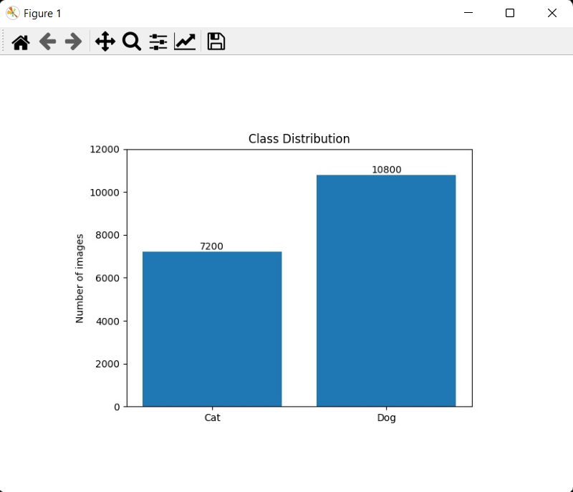
5.2 (3%) Plot class distribution of training dataset
(出題：Benjamin)
Objective
At home:
Load the training dataset
Iterate through the dataset and count the number of images of each class
Plot the class distribution
→ Hint: use matplotlib.pyplot functions to plot
(a) figure()
(b) bar()
(c) xticks()
(d) ylabel()
Save the figure
When the demo:
Click the button “2. Show Distribution”
Show the saved figure of class distribution in a new window
Figure: Class Distribution
Notice: this is an example, the numbers might differ

Slide 22
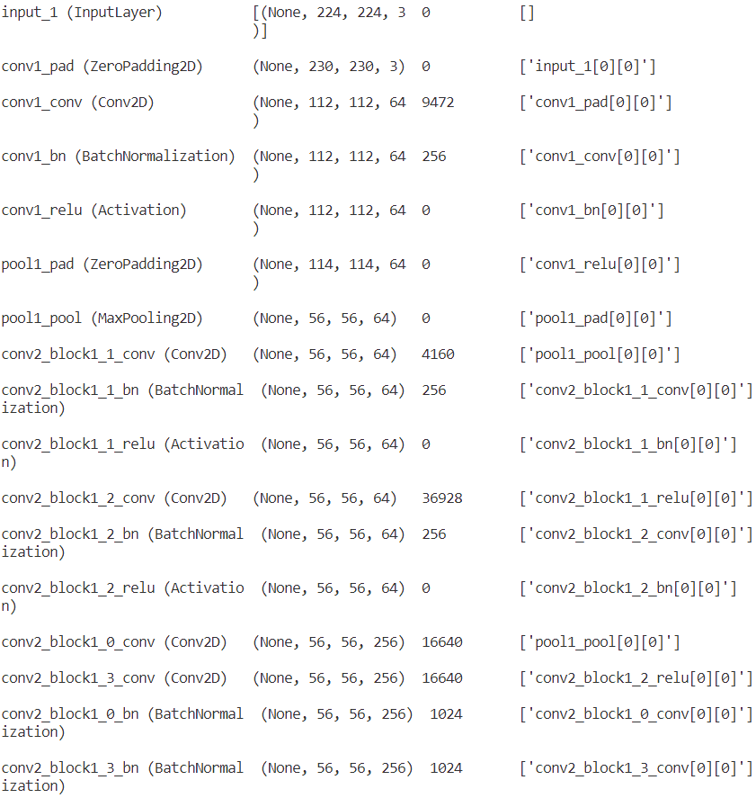
5.3 (3%) Show the structure of ResNet50 model
(出題：Benjamin)
Objective
At home:
Build a ResNet50 model
→ Hint:
(a) TensorFlow: tf.keras.applications.resnet50.ResNet50()
(b) PyTorch: torchvision.models.resnet50()
Replace the output layer to a FC (Fully Connected) layer of 1 node with a Sigmoid activation function
→ Hint:
(a) TensorFlow (tutorial): tf.keras.layers.Dense(1, activation=‘sigmoid’)
(b) PyTorch (tutorial): torch.nn.Linear(2048, 1), torch.nn.Sigmoid
If the class label of Cat is 1, the output value (range: 0 ~ 1) should be close to 1 for cat images, and vice versa.
Run the function to show the structure in the terminal
→ Hint:
(a) TensorFlow: tf.keras.Model.summary()
(b) PyTorch: torchsummary
When the demo:
Click the button “3. Show Model Structure”
Run the function to show the structure in the terminal
Feature map shape
(B, H, W, C)
Num. of param.
Layer (type)
Layer connecting to
Figure: the structure of ResNet50 model

Slide 23
5.3 (3%) Show the structure of ResNet50 model
(出題：Benjamin)
How to read the structure
Input: an RGB image 224×224×3c
Feature map shape
(B, H, W, C)
Num. of param.
Layer (type)
Layer connecting to
112×112×64c
3×3
/2: stride = 2
56×56×256c
×3
Every conv layer is followed by a BN layer and a ReLU layer
28×28×512c
×3
BN: Batch Normalization
ReLU: Rectified Linear Unit
×5
14×14×1024c
Figure: the structure of ResNet50 model
×2
7×7×2048c
global avg pool
FC, 1c
FC: fully connected
Output: a confidence value (range: 0 ~ 1)

Slide 24
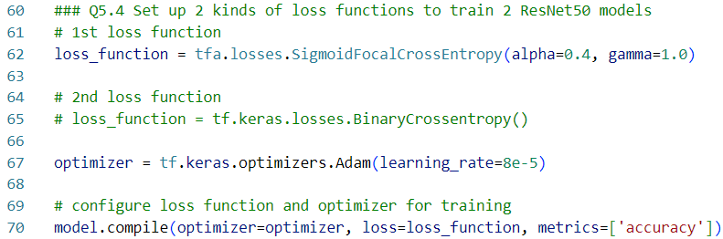
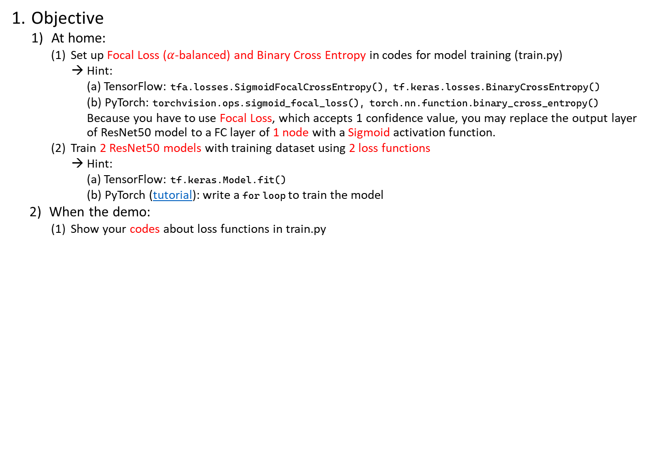
5.4 (3%) Set up 2 kinds of loss functions to train 2 ResNet50 models
(出題：Benjamin)
Objective
At home:
Set up Focal Loss ($α$-balanced) and Binary Cross Entropy in codes for model training (train.py)
→ Hint:
(a) TensorFlow: tfa.losses.SigmoidFocalCrossEntropy(), tf.keras.losses.BinaryCrossEntropy()
(b) PyTorch: torchvision.ops.sigmoid_focal_loss(), torch.nn.function.binary_cross_entropy()
Because you have to use Focal Loss, which accepts 1 confidence value, you may replace the output layer of ResNet50 model to a FC layer of 1 node with a Sigmoid activation function.
Train 2 ResNet50 models with training dataset using 2 loss functions
→ Hint:
(a) TensorFlow: tf.keras.Model.fit()
(b) PyTorch (tutorial): write a for loop to train the model
When the demo:
Show your codes about loss functions in train.py
Train a model with Focal Loss
Train another model with Binary Cross Entropy
Figure: Code example (you can follow the hyperparameter settings)

Slide 25
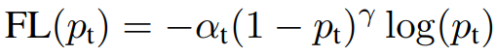
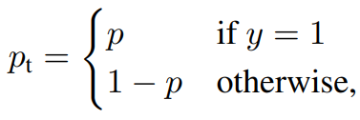
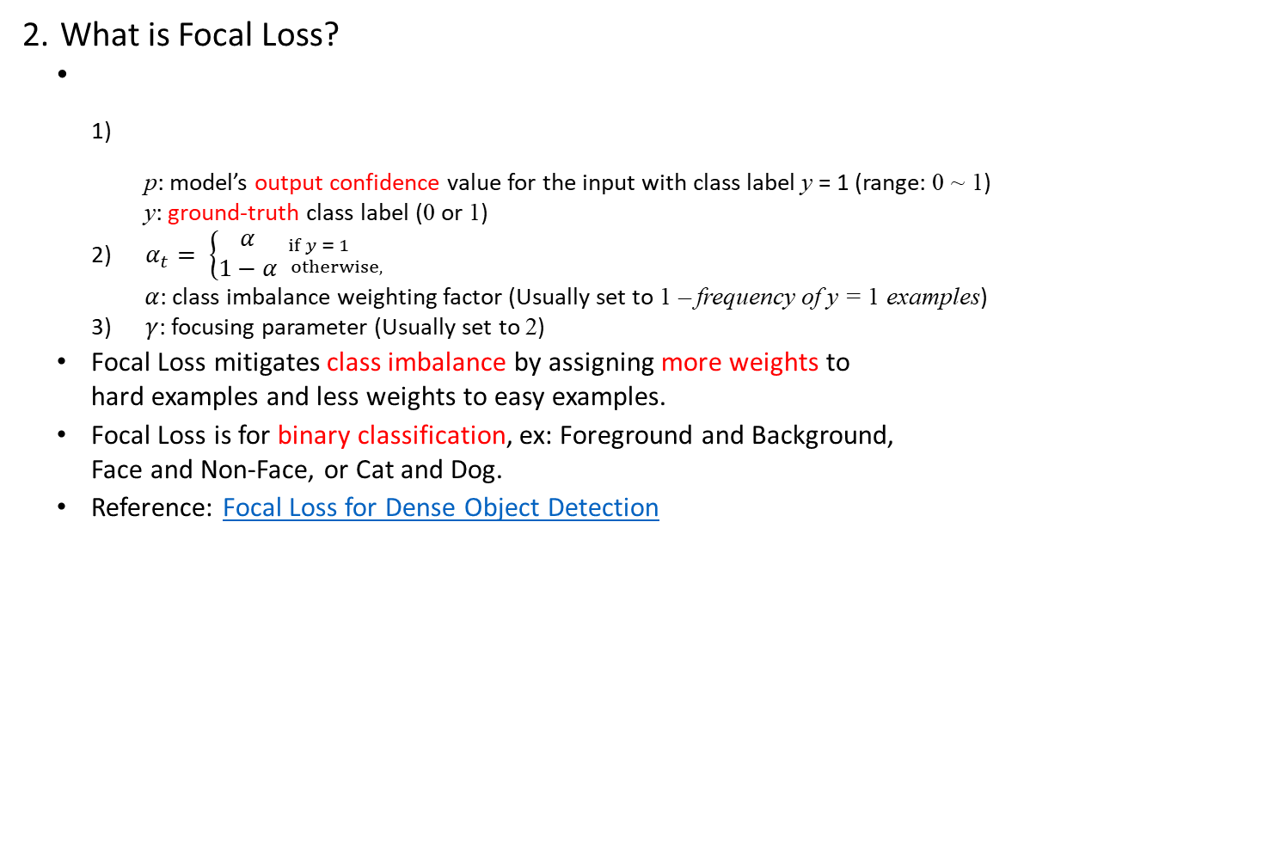
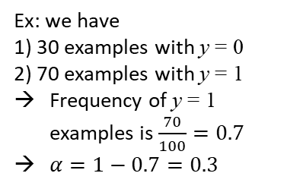
5.4 (3%) Set up 2 kinds of loss functions to train 2 ResNet50 models
(出題：Benjamin)
What is Focal Loss?
p: model’s output confidence value for the input with class label y = 1 (range: 0 ~ 1)
y: ground-truth class label (0 or 1)
$α_{t}= \left\{\begin{aligned}α \\ 1−α\end{aligned}{if y = 1 \atop otherwise,}\right.$
$α$: class imbalance weighting factor (Usually set to 1 – frequency of y = 1 examples)
$γ$: focusing parameter (Usually set to 2)
Focal Loss mitigates class imbalance by assigning more weights to hard examples and less weights to easy examples.
Focal Loss is for binary classification, ex: Foreground and Background, Face and Non-Face, or Cat and Dog.
Reference: Focal Loss for Dense Object Detection
Ex: we have
1) 30 examples with y = 0
2) 70 examples with y = 1
Frequency of y = 1 examples is $\frac{70}{100}=0.7$
$α=1−0.7=0.3$

Slide 26
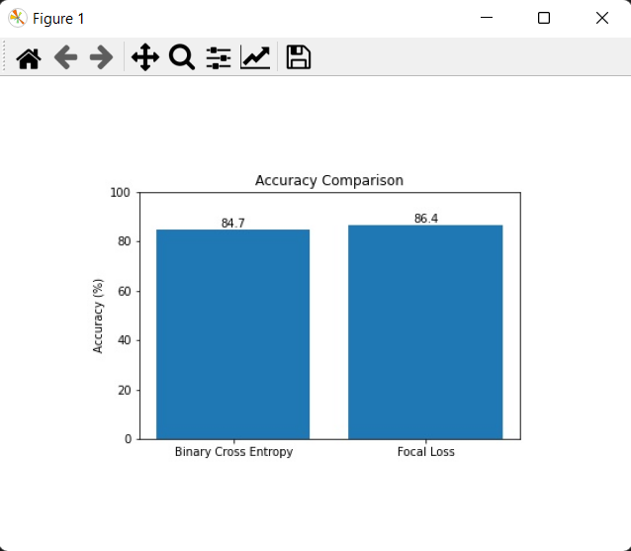
5.5 (4%) Compare the accuracies of 2 ResNet50 models on validation dataset
(出題：Benjamin)
Objective
At home:
Validate 2 ResNet50 models with validation dataset
→ Hint:
(a) TensorFlow: tf.keras.Model.evaluate()
(b) PyTorch (tutorial): write a for loop to validate the model
Plot the accuracy values with a bar chart
Save the figure
When the demo:
Click the button “4. Show Comparison”
Show the saved figure of accuracy comparison in a new window
Figure: Accuracy Comparison
Notice: this is an example, the numbers might differ

Slide 27
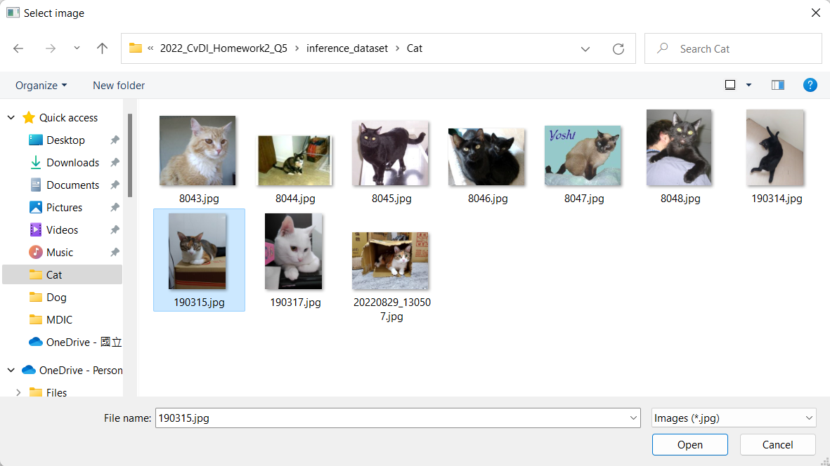
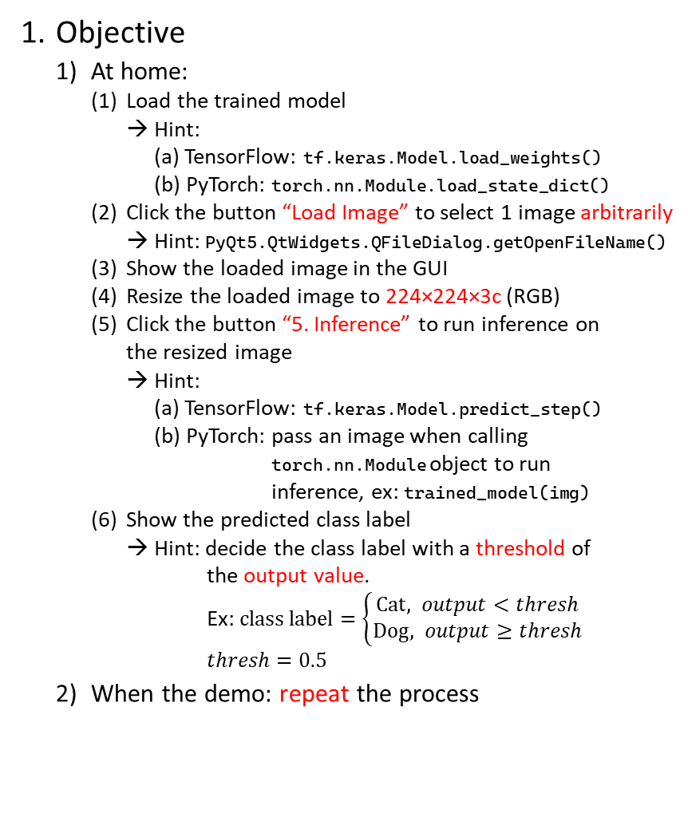
5.6 (4%) Use the better-trained model to run inference and show the predicted class label
(出題：Benjamin)
Objective
At home:
Load the trained model
→ Hint:
(a) TensorFlow: tf.keras.Model.load_weights()
(b) PyTorch: torch.nn.Module.load_state_dict()
Click the button “Load Image” to select 1 image arbitrarily
→ Hint: PyQt5.QtWidgets.QFileDialog.getOpenFileName()
Show the loaded image in the GUI
Resize the loaded image to 224×224×3c (RGB)
Click the button “5. Inference” to run inference on the resized image
→ Hint:
(a) TensorFlow: tf.keras.Model.predict_step()
(b) PyTorch: pass an image when calling torch.nn.Module object to run inference, ex: trained_model(img)
Show the predicted class label
→ Hint: decide the class label with a threshold of the output value. Ex: $class label=\left\{\begin{aligned}Cat, output<thresh \\ &Dog, output≥thresh\end{aligned}\right.$
$$thresh=0.5$$
When the demo: repeat the process
(2) Select 1 image arbitrarily
(3) Show the loaded image
(4) Resize the loaded image to 224×224×3c
(2) Select 1 image arbitrarily
(6) Show the predicted class label
(5) Run inference on the loaded image

